Slide 1


FQ3 2025-2026
Earnings
Call
February 17, 2026

Slide 2
Disclaimer
Forward-Looking Information / Statements
Certain statements contained in this presentation are not historical facts and may be forward-looking statements within the meaning of the Private Securities Litigation Reform Act of 1995. Words such as "plans," "expects," "believes," "anticipates," and similar words are intended to identify forward-looking statements. These forward-looking statements include, but are not limited to, statements concerning our expected revenue growth and improved profitability, and our financial forecasts. Forward-looking statements are based on our current expectations and beliefs and involve a number of risks and uncertainties that are difficult to predict and that could cause actual results to differ materially from those stated or implied by the forward-looking statements. A description of certain of these risks, uncertainties and other matters can be found in filings we make with the U.S. Securities and Exchange Commission, all of which are available at www.sec.gov. Because forward-looking statements involve risks and uncertainties, actual results and events may differ materially from results and events currently expected by us, readers are cautioned not to place undue reliance on these forward-looking statements, which speak only as of the date hereof. We undertake no obligation to publicly update these forward-looking statements to reflect events or circumstances that occur after the date hereof or to reflect any change in its expectations with regard to these forward-looking statements or the occurrence of unanticipated events.
Financial Information; Use of Projections
The financial and operating forecasts and projections contained herein represent certain estimates of Zoomcar as of the date thereof and include projected financial numbers, including revenues, valuation and other metrics derived therefrom. Zoomcar’s independent public accountants and auditors have not examined, reviewed or compiled the forecasts or projections and, accordingly, does not express an opinion or other form of assurance with respect thereto. Furthermore none of Zoomcar or its management team can give any assurance that the forecasts or projections contained herein accurately represents Zoomcar’s future operations or financial condition. Such information is subject to a wide variety of significant business, economic and competitive risks and uncertainties that could cause actual results to differ materially from those contained in the prospective financial information, including the risks and uncertainties described in the "Risk Factors" section of the Form 10-K and Form 10-Qs filed by Zoomcar and incorporated by reference therein. Accordingly, there can be no assurance that the prospective results are indicative of the future performance of Zoomcar or that actual results will not differ materially from those presented in these materials. Some of the assumptions upon which the projections are based inevitably will not materialize and unanticipated events may occur that could affect results. Therefore, actual results achieved during the periods covered by the projections may vary materially from the projected results. Inclusion of the prospective financial information in these materials should not be regarded as a representation by any person that the results contained in the prospective financial information are indicative of future results or that any results will be achieved.
Use of Non-GAAP Financial Matters
This Presentation includes certain financial measures not presented in accordance with generally accepted accounting principles (“GAAP”) with respect to Zoomcar’s expected future performance and other metrics derived therefrom. Specifically, this Presentation includes contribution margin and EBITDA. These non-GAAP financial measures may exclude items that are significant in understanding and assessing Zoomcar’s financial results. These non-GAAP measures are an addition, and not a substitute for or superior to measures of financial performance prepared in accordance with GAAP and should not be considered as an alternative to net loss, operating loss or any other performance measures derived in accordance with GAAP as a measure of our liquidity, profitability or performance. Not all of the information necessary for a quantitative reconciliation of these non-GAAP financial measures to the most directly comparable GAAP financial measures is available without unreasonable efforts at this time. Zoomcar believes that these forward-looking non-GAAP measures of financial results provide useful supplemental information about Zoomcar. Zoomcar’s management uses these forward-looking non-GAAP measures to evaluate Zoomcar’s projected financial and operating performance. However, there are a number of limitations related to the use of these non-GAAP measures and their nearest GAAP equivalents. For example other companies may calculate non-GAAP measures differently or may use other measures to calculate their financial performance, and therefore Zoomcar’s non-GAAP measures may not be directly comparable to similarly titled measures of other companies. The presentation of such non-GAAP measures, which may include adjustments to exclude unusual or non-recurring items, should not be construed as an inference that Zoomcar’s future results and cash flows will be unaffected by other unusual or nonrecurring items.
Industry and Market Data
This Presentation has been prepared by Zoomcar and includes market data and other statistical information from third-party sources. Although Zoomcar believes these third-party sources are reliable as of their respective dates, none of Zoomcar, or any of its respective affiliates has independently verified the accuracy or completeness of this information. Some data are also based on Zoomcar’s good faith estimates, which are derived from both internal sources and the third-party sources described above. None of Zoomcar, its respective affiliates, nor their respective advisors, directors, officers, employees, members, partners, shareholders or agents make any representation or warranty with respect to the accuracy of such information. None of Zoomcar or its respective affiliates, advisors, directors, officers, employees, members, partners, shareholders or agents or the providers of any such third party information or any other person are responsible for any errors or omissions therein (negligent or otherwise), regardless of the cause, or the results obtained from the use of such content. Each of Zoomcar and its respective affiliates, advisors, directors, officers, employees, members, partners, shareholders and agents expressly disclaims any responsibility or liability for any damages or losses in connection with the use of such information herein.
Trademarks and Intellectual Property
All trademarks, service marks, and trade names of Zoomcar or its affiliates as used herein are trademarks, service marks, or registered trade names of Zoomcar or its affiliates. Any other product, company names, or logos mentioned herein are the trademarks and/or intellectual property of their respective owners, and their use is solely for convenience and is not intended to, and does not imply, a relationship with Zoomcar, or an endorsement or sponsorship by or of Zoomcar or any other party. The trademarks, service marks and trade names referred to in this presentation may appear without the ®, TM or SM symbols, but such references are not intended to indicate, in any way, that Zoomcar will not assert, to the fullest extent under applicable law, their rights or the right of the applicable licensor to these trademarks, service marks and trade names.

Slide 3


Leading India’s Self-Drive Car Sharing Revolution
Zoomcar is India’s largest peer-to-peer car-sharing marketplace.
100+
10M+
42K+
152
90%
700K
Cities
All time Guests
All time cars
Employees
Brand Awareness
Monthly Rental Sessions
pan-India presence
Trust our platform
Onboarded on marketplace
Driving innovation
Market leadership
without performance spends
4.79/5
#1
2X
55%
Avg Guest Rating
Search & Brand Recall
Organic Conversion
Repeat User Trips
focus on experience
Highest brand awareness in India for car rentals
better then paid traffic
of total monthly trips

Slide 4
FQ 3 25-26 Business Highlights
Recorded Contribution Profit of $1.38mn for the quarter ended Dec 31, 2025 .
Ninth consecutive quarter of positive contribution profit
Generated a record contribution profit of $14.10 per booking served during the current Fiscal quarter (vs Contribution profit of $12.39 per booking served during the previous comparable quarter)
Adjusted EBITDA loss reduced quarter over quarter by 74% and an improvement of 52% for nine months ended December 31, 2025 vs nine months ended December 31, 2024.
Loss Attributable to stockholders for the current Fiscal quarter reduced significantly to USD 0.72 MM down from USD 7.92 MM during the comparable Fiscal quarter ended December 2024.
Focus on improving customer experience leading to improved Host metrics
Number of Host with 4.5+ rating grew by 6% year over year.
Repeat users contributed to 58% of the overall booking (without significant incentivization or discounts for more than 6 quarters) representing the overall Brand value and advocacy for platform experience (vs 56% in FQ3 2024).
September 2023
September 2024
FQ3 2025 represents the 3 months ended December 31, 2025; FQ3 2024 represents the 3 months ended December 31, 2024.

Slide 5






The Perfect Timing for Marketplace Acceleration
A Once-in-a-Decade Opportunity to Consolidate India's P2P Mobility Market
Massive Demand Surge
Intent Shift
Low Penetration
India's self-drive car-sharing TAM expanding from 18.5M (2025) → 65M (2031) (USD 28.6B Opportunity)
ownership is high-commitment; intent is shifting toward access.
Only 0.1 registered cars per household in India vs 1.8 in the U.S., giving structural headroom for decades of growth.
High Digital Readiness
Unit Economics Inflection
Over 1 billion internet users; 65% of India's population to be working-age by 2031.
Booking-level contribution margin improving from –$2.5 (Dec'23) → +$14.10 (Dec'25) — proof that the model now scales profitably.
Key Message: The macro is ready, the digital infrastructure is mature, and Zoomcar's model is already validated.
9

Slide 6

Financials Overview

Slide 7
Operational and Financial Measures
For the Fiscal quarter ended Dec 31, | FQ-3 2025 | FQ-3 2024 | YoY % Change
Operating Metrics
Number of Bookings | 97,662 | 103,599 | (6%)
GBV ($mn) | 6.60 | 6.54 | 1%
Average Guest Trip Rating (Out of 5)* | 4.79 | 4.69
Financial Measures ($mn)
Revenue | 2.37 | 2.45 | (3)%
Contribution Profit | 1.38 | 1.28 | 7%
(Contribution Profit/Booking) | 14.10 | 12.39 | 14%
(As a percentage of Revenue) | 58% | 52% | 600 bps
Loss from Operations* | (1.47) | (3.24) | (54%)
Adjusted EBITDA Loss Loss attributable to shareholders | (0.83) (0.72) | (3.15) (7.92) | (74%) (91%)
*If we exclude the impact of non cash cost of RSU amounting to USD 0.62 MM during the quarter, the loss from operations for the quarter ended December 2025 was $ 0.86. Mn which is 74% improvement from the comparable quarter ended December 2025.

Slide 8
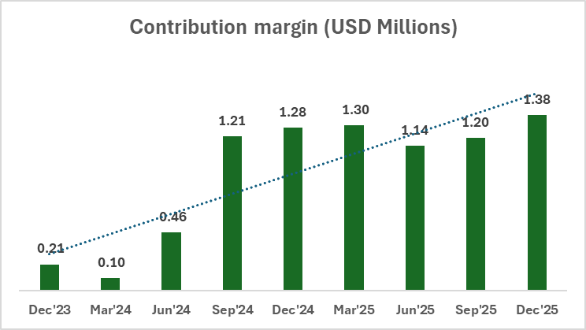
Ninth Consecutive Quarter of Positive Contribution Profit

Slide 9
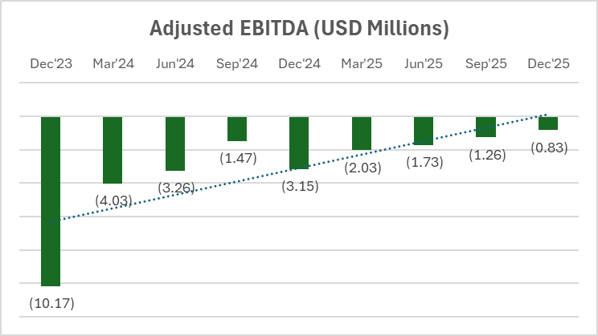
Adjusted EBITDA - AN UPWARD TREND

Slide 10





Fundraising Update
GROWTH CAPITAL
& EXPANSION
BRIDGE ROUND
WARRANT
EXCHANGE OFFER
Actively raising growth capital
to fund the next phase of expansion.
Launched a private placement bridge
round with a $2M minimum and up to $10M including overallotment.
Launched a warrant exchange tender
offer to simplify capital structure.
UPLIST TARGET (IPO/FINANCING)
DEBT RESTRUCTURING & SUSTAINABILITY
Engaged an investment bank to support evaluation
of a potential uplist on a premier U.S.
national securities exchange.
Continuing debt restructuring to reduce balance-sheet
burden and improve sustainability—working towards
positive net worth with minimal cash burn.
Notes:
[Sources] - Icons were cropped from the user-provided reference slide image. [/Sources]

Slide 11

Appendix:
GAAP to Non GAAP Adjustment

Slide 12
Contribution Profit/Loss
All numbers in $ (USD) | For the Three Months Ended Dec 31, |  | For the Nine Months Ended Dec 31,
 | FY2025-26 | FY2024-25 | FY2025-26 | FY2024-25
Net revenue | $ 2,365,059 | $ 2,449,368 | $ 6,964,922 | $ 6,937,250
Cost of revenue | 1,080,116 | 1,499,282 | 3,591,092 | 4,224,993
Gross Profit/(Loss) | 1,284,943 | 950,086 | 3,373,830 | 2,712,257
Add: Depreciation and amortization in COR | 13,258 | 73,683 | 58,985 | 222,862
Add: Overhead costs in COR (rent, software support, insurance, travel) | 106,366 | 286,639 | 433,341 | 636,960
Add: Stock Based Compensation in COR | 53,251 | - | 88,067 | -
Less: Host Incentives and Marketing costs (excl. brand marketing) | 81,099 | 26,414 | 242,253 | 621,158
Less: Host incentives | 16,412 | 32,800 | 93,567 | 110,664
Less: Marketing costs (excl. brand marketing) | 64,687 | (6,386) | 148,686 | 510,494
Contribution Profit / (Loss) | 1,376,719 | 1,283,994 | 3,711,970 | 2,950,921
Contribution margin | 58% | 52% | 53% | 43%

Slide 13
Adjusted EBITDA
 | For the Three Months Ended Dec 31, |  | For the Nine Months Ended Dec 31,
 | FY 2025-26 | FY 2024-25 | FY 2025-26 | FY 2024-25
Net (Loss) | $ (721,472) | $ (7,922,063) | $ (5,720,934) | $ (13,805,617)
Add/(deduct)
Stock-based compensation | 618,227 | - | 1,303,279 | -
Depreciation and amortization Finance costs | 25,315 474,036 | 90,521 4,050,856 | 95,795 1,377,849 | 305,658 6,127,161
Other (income)/expenses, net | (1,226,383) | 757,826 | (799,361) | (29,297)
Gain on troubled debt restructuring | - | (124,299) | (72,912) | (476,746)
Adjusted EBITDA | $ (830,277) | $ (3,147,159) | $ (3,816,284) | $ (7,878,841)

Slide 14
5 Big Wins Powering Our Turnaround
Metric | For the Three Months Ended Dec 31, |  | YoY Improvement
 | FY2025-26 | FY2024-25
Gross Booking Value | $6.60M | $6.54M | 1% organic Growth w/o paid marketing
Repeat User Booking Contribution | 58% | 52% | High repeat user stickiness
Contribution per Booking | $14.10 | $12.39 | Generating $1.38 MM in Dollar terms /~54% of Net GAAP revenue
Adjusted EBITDA | –$0.83M | –$3.15M | 74% Improvement
Improvement in Loss attributable to shareholders | –$0.72M | –$7.92M | 91% Improvement

Slide 15
Thank you!

